Slide 1
Analysis On Used Cars
By Ravi Kumar

Slide 2
Agenda :
01
Introduction
Problem Statement
02
Data Analysis
03
Inferences
04

Slide 3
1. Introduction
Following are the 10 features given in the dataset.
Id | Feature | Description
1 | car | Car brand name
2 | model | Available car different Variants
3 | year | purchasing Year
4 | body | Body type-Hatchback, Sedan, Crossover etc
5 | mileage | car Mileage
6 | engV | Engine version
7 | engType | Car Fuel type - Petrol, Diesel, gas etc
8 | drive | Wheel Drive Front, back
9 | registration | Check if the vechile is registered
10 | price | Price of Car in $

Slide 4
Features that may or may not impact Price of a Car
2. Problem Statement
01
02
03
Correlation In Features
Most Selling Cars
In terms of price, volume brand etc.

Slide 5
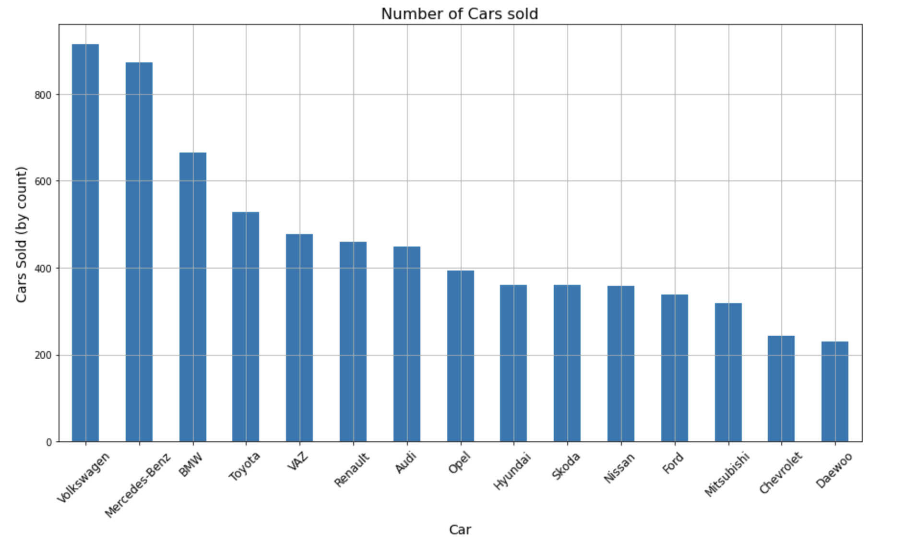
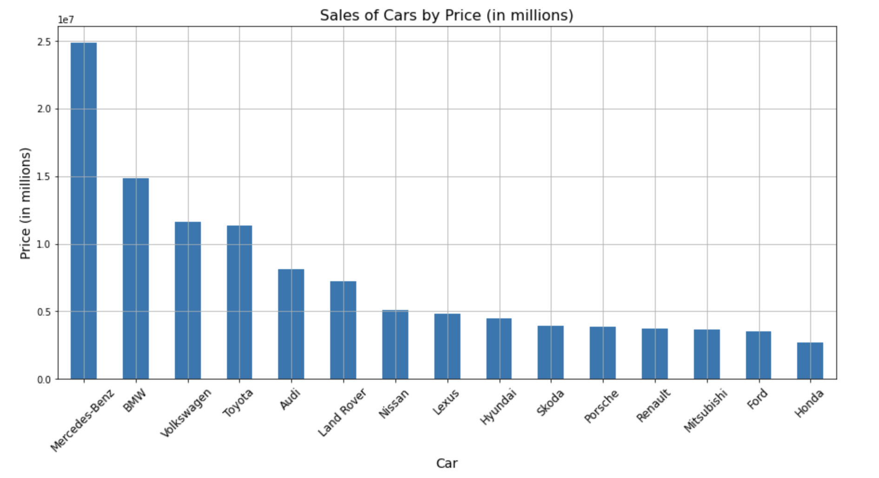
3. Data Analysis
Which Car is sold most with respect to volume and price?
Volkswagen is the top most selling cars in terms of volume followed by Mercedes-Benz, BMW, Toyota and VAZ which is 37% of overall sales of cars. Volkswagen alone holds 10% from overall sales.
Mercedes is the top most selling car with respect to the Price followed by BMW, Volkswagen, Toyota and Audi.

Slide 6
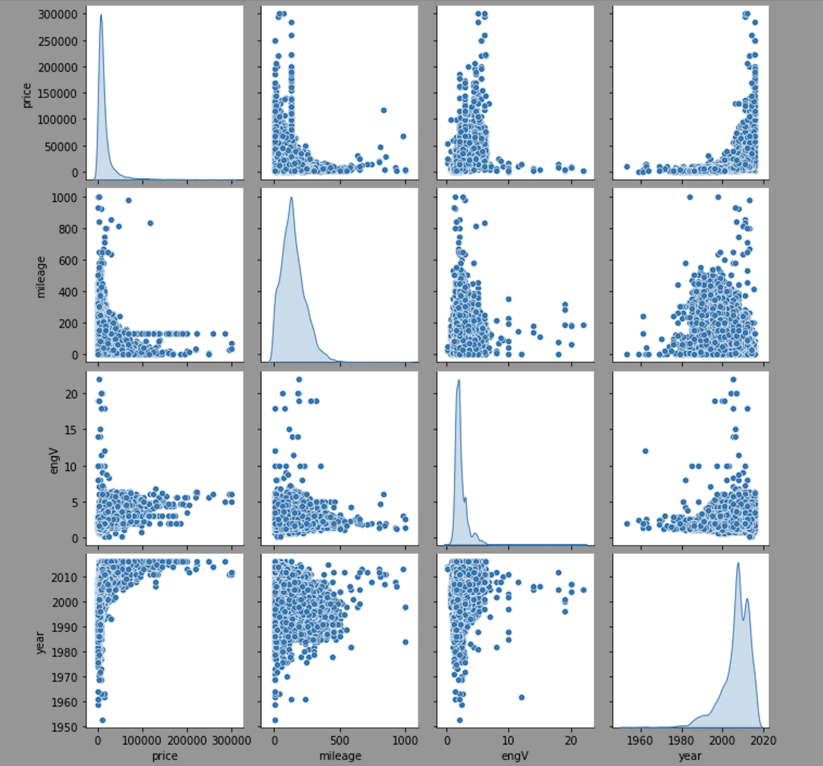
Features Correlation with Price
Mileage and Price has negative correlation.
Engine Variant and Price has positive relation.
Year and Price also have positive relation which depicts if year is high then the price of car would also be high too.

Slide 7
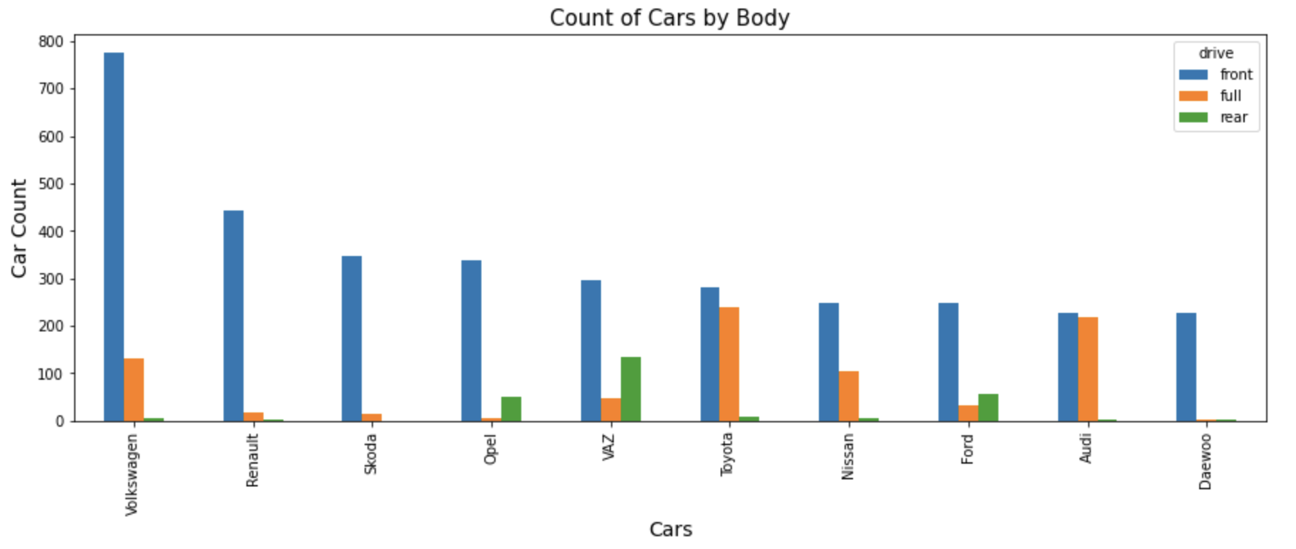
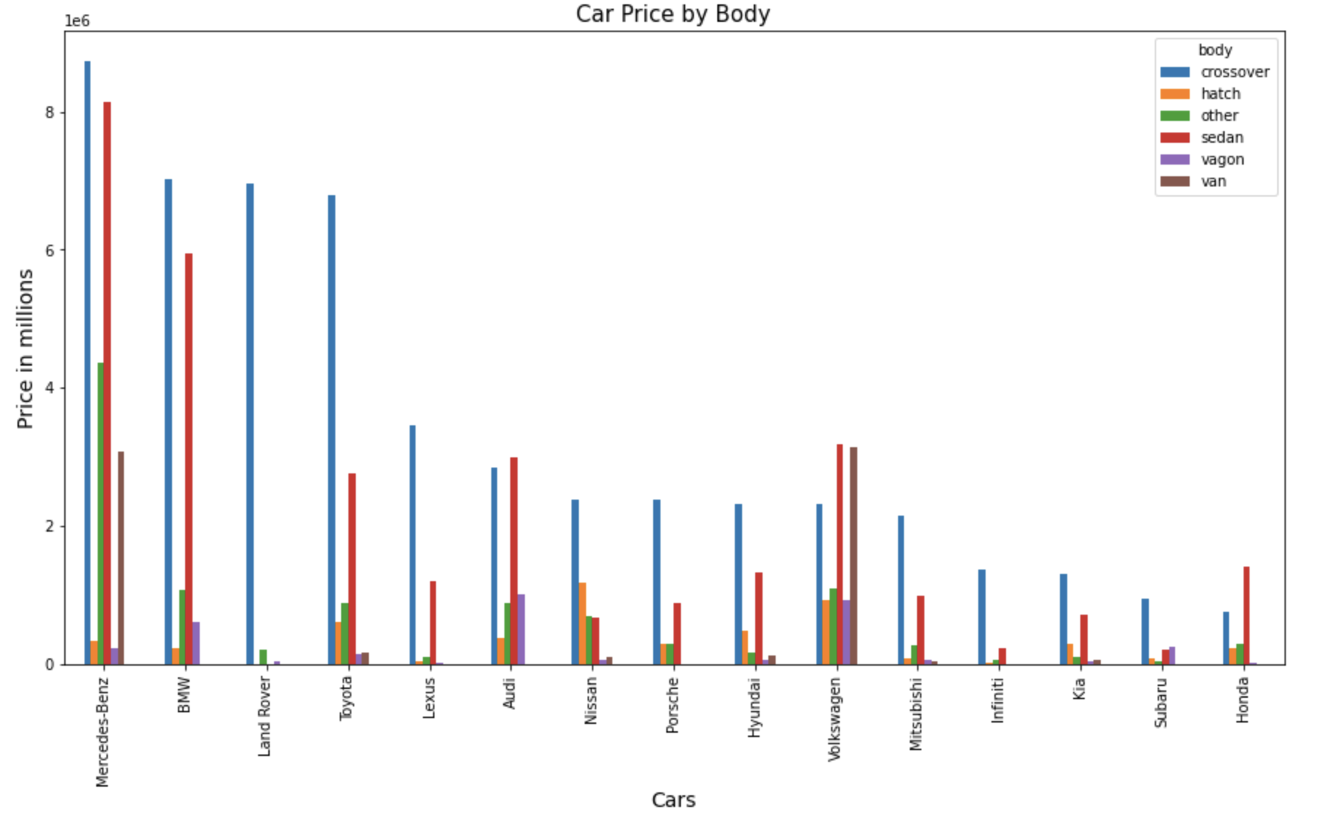
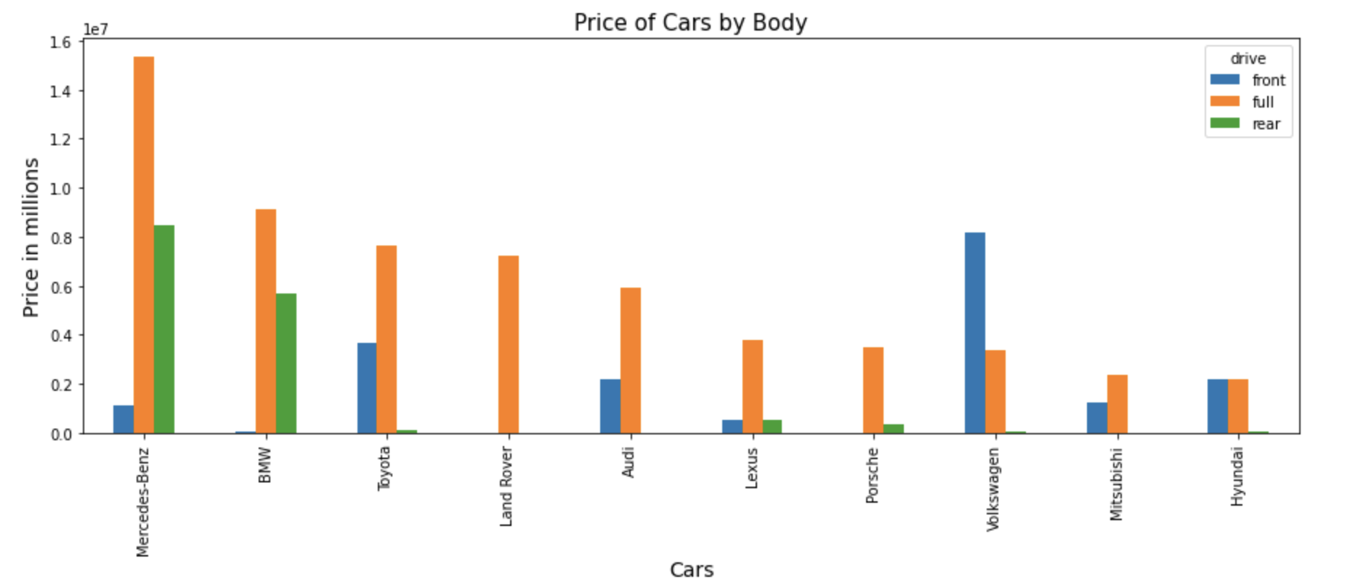
Drive & Body impact on Price.
Crossover is the most selling Body type across any Car Category followed by Sedan cars.
Merced-Benz and BMW has most selling cars’ Body with respect to Price and Volume
Front Drive cars are sold most in terms of volume.
Front Drive cars are cheaper than the Full drive cars.
Full drive cars are premium and hence such cars have more re-sale price.

Slide 8
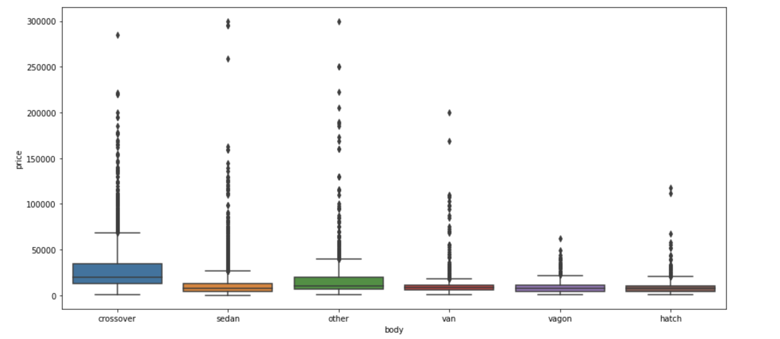

Slide 9
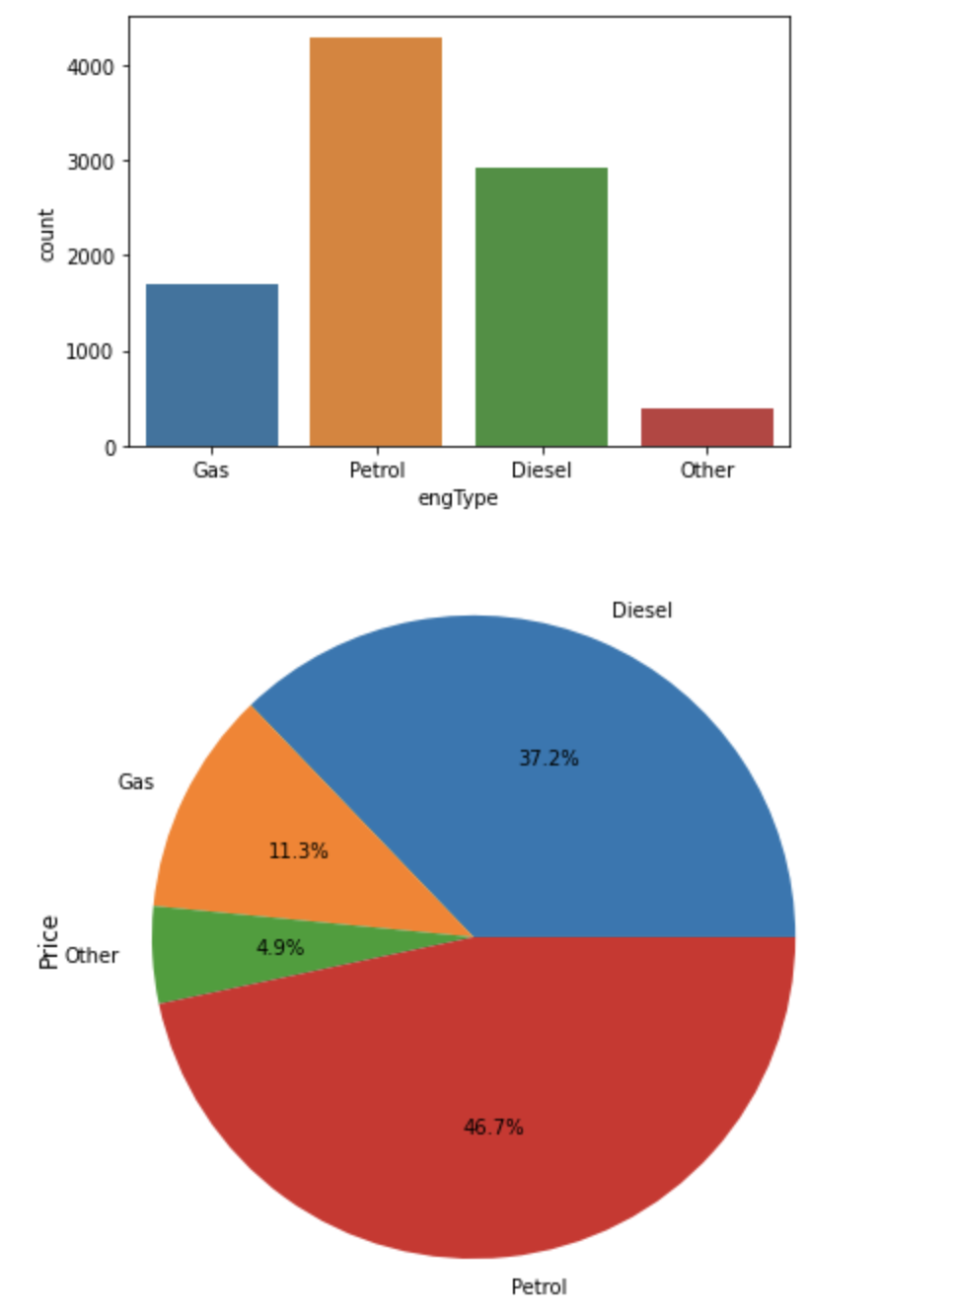
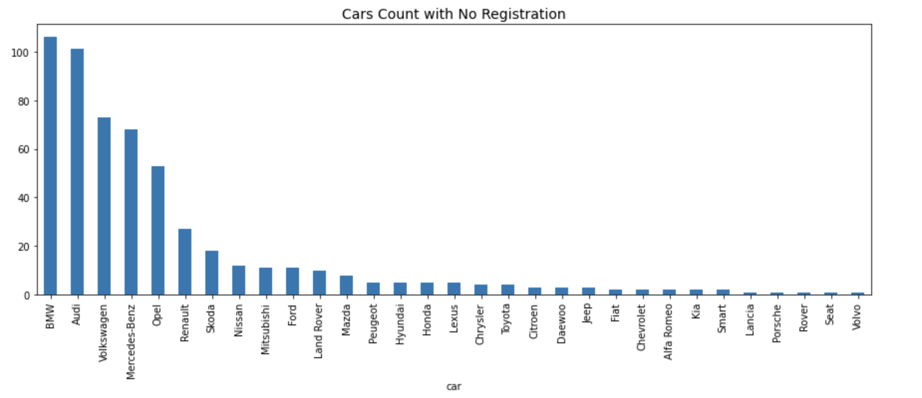
engType and Registration impact on Price.
Almost, 500 cars don’t have Registrations
Petrol cars are sold most Followed by Diesel and Gas cars

Slide 10
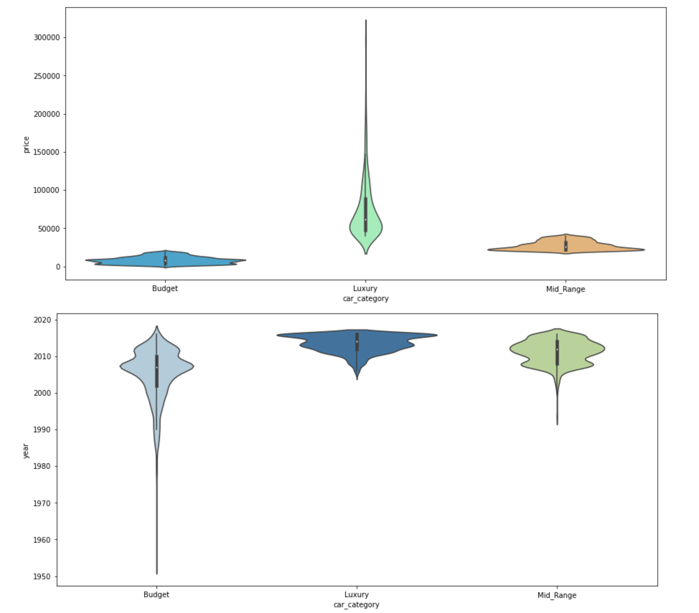
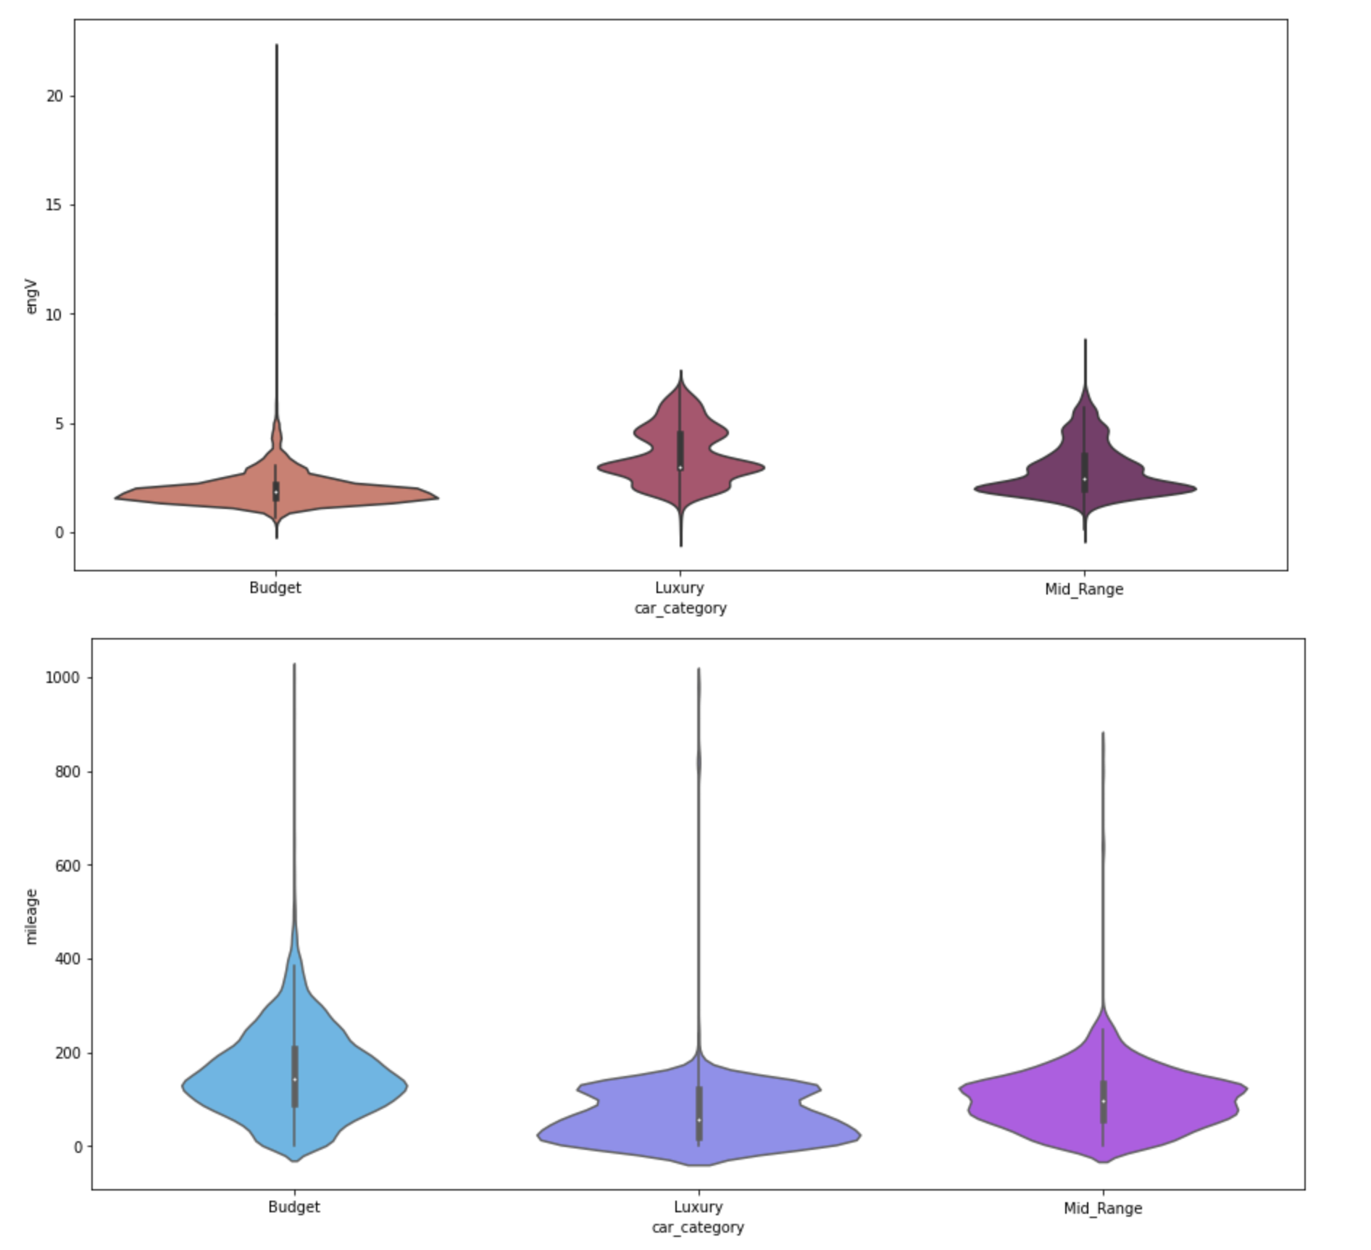
Car Category analysis with respect to Price, Year, engV and Mileage
Mid Range Cars -
Have low mileage and high prices.
50% cars sold have year < 10
engV is between 2 - 5.
Luxury Cars -
Are very low in mileage and very high in price.
Cars with recent Year sold on very high prices
50% cars have engV > 2.5
Budget Cars -
have high mileage and low price
Cars Year < 2000 sold in very low prices
50% cars have engV =2

Slide 11
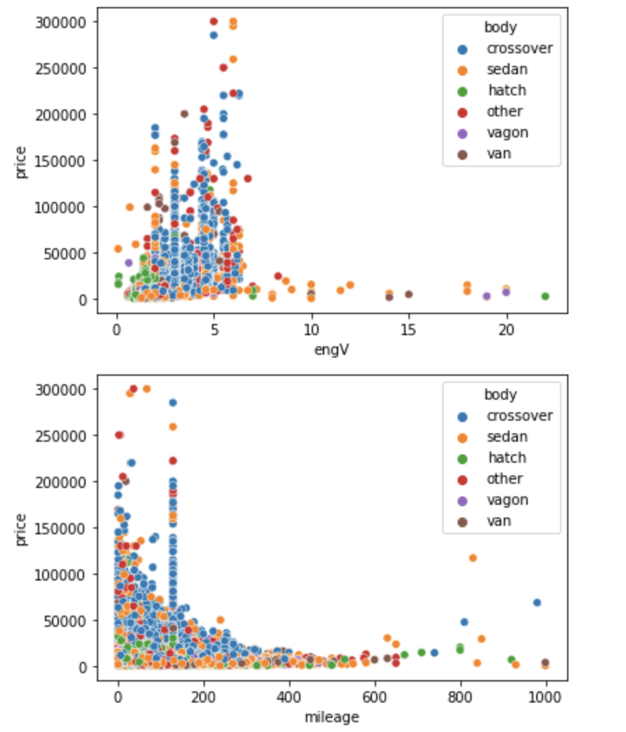
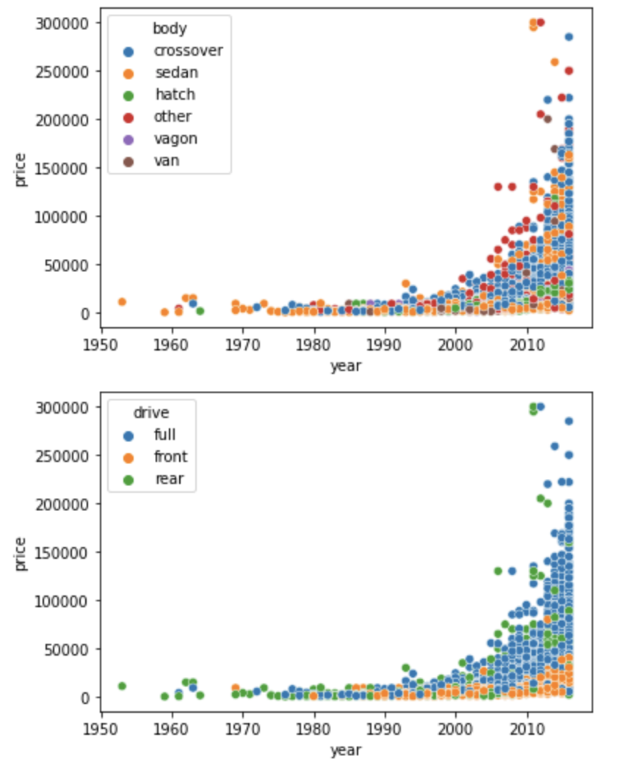

Slide 12
4. Inferences / Insight
Our target audience is more declined towards Budget cars
Dealing in Budget Cars should be good
Sale of Crossover and Sedan Body of car could be beneficial in any Car Category
Luxury cars might have less sales but would give more profits in terms of Price
Car Category | Sales (in %) | Selling Price (in %)
Budget | 81% | 45%
Mid Range | 12% | 21%
Luxury | 7% | 34%

Slide 13
THANKS
Do you have any questions?
Ask over email :
rvchaudhary48@outlook.com

